Slide 1




UOC FOS
IT 4004 Advance Database Systems
PROJECT PROGRESS
ATTENDANCE SYSTEM

Slide 2


Project Title
STUDENTS ATTENDANCE SYSTEM USING FACIAL RECOGNITION TECHNOLOGY AND STUDENT ATTENDANCE DATA VISUALIZATION

Slide 3


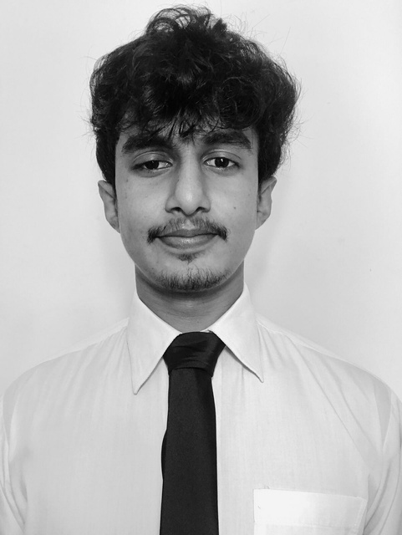





OUR TEAM
Rukshan
Nethmi
Kalana
Eranga
Sandali
14635
14871
14622
14800
14846

Slide 4


INNOVATIVE IDEA
Problem: The traditional method of attendance is time-consuming and error-prone.
Solution: Facial recognition technology can be used to automate the attendance taking process.

Slide 5



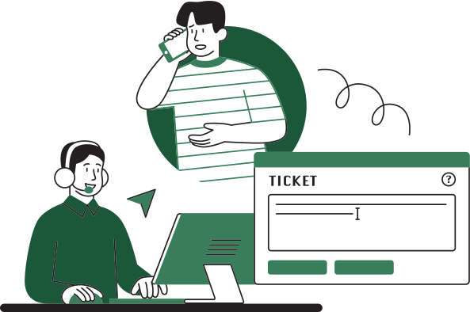


OUTLINE
Ready the setup and webcam along with graphics
01
OF THE PROJECT
Encoding generator & face recognition
02
03
Setup the database & add data and images to the database
Update attendance and limit the number of attendance per day
04
05
Attendance data visualization

Slide 6


MAIN INTERFACE

Slide 7
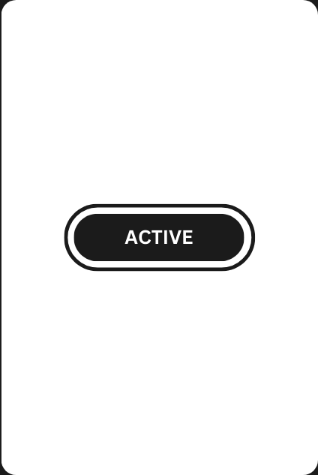



SUB INTERFACES - MODES

Slide 8


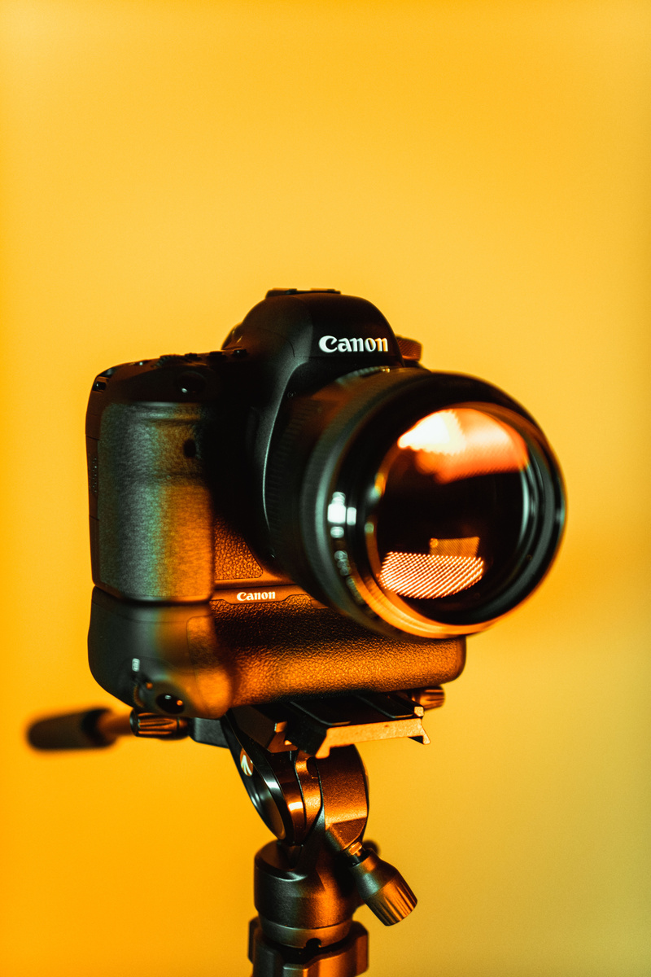
TOOLS AND TECHNOLOGIES
Python
Firebase
WebCam
Pycharm IDE for python
Python libraries:
Cmake
Dlib
Face-recognition
Pickle
Numpy
OpenCV
Real-Time Database by Google
keep data in sync across multiple devices in real-time
Laptop web-camera

Slide 9
MAIN SCRIPT
1. Importing Libraries - Including `os`, `pickle`, `numpy`, `cv2` (OpenCV), `face_recognition`, `cvzone`, `firebase_admin`, and `datetime`
2. Firebase Initialization - Initializes a connection to Firebase using credentials. And specifies the Firebase database and storage bucket to be used.
3. Camera Setup - Initializes a video capture using OpenCV for the web camera .

Slide 10
MAIN SCRIPT
4. Loads the background image
5. Loads the list of mode images, displayed on the interface based on the program's state
6. Loading Known Face Encodings and associated student IDs from a pickle file.
7. Main Loop - Where it continuously captures frames from the webcam

Slide 11
MAIN SCRIPT
8. Face Recognition - Processes the image to detect faces and extract their encodings using the `face_recognition` library. If a recognized face is detected, it updates the interface with relevant student information from Firebase.
9. Attendance Tracking - by checking the time since the last attendance record. If more than a certain time has passed since the last attendance, it updates the attendance count and records the new attendance time in the Firebase database.

Slide 12
MAIN SCRIPT
10. Interface Updates - Updates the GUI with student information and mode images based on various conditions and states.
11. Termination - The main loop continues until the user closes the application window

Slide 13
ENCODE GENERATOR SCRIPT
01. Imports necessary libraries/modules:
- `cv2`: OpenCV library for computer vision tasks.
- `face_recognition`: A library for face recognition tasks.
- `pickle`: Used for serializing Python objects.
- `os`: Provides functions for interacting with the operating system.
- `firebase_admin`: A Python library for Firebase services.
02. Initializes Firebase services using a service account key (`serviceAccountKey.json`) to connect to the Firebase Realtime Database and Firebase Storage. This code block sets up the connection to Firebase
03. Specifies a folder path ('Images') where student images are located. It lists the files in that folder and prepares to load and process those images.

Slide 14
ENCODE GENERATOR SCRIPT
04. Iterates through the list of image files in the specified folder ('Images')
05. Defines a function `findEncodings` that takes a list of images, converts each image to RGB format, and computes face encodings for each image using the `face_recognition` library. The computed encodings are appended to the `encodeList`.
06. Prints a message indicating that encoding is starting.
07. Calls the `findEncodings` function with the list of loaded student images (`imgList`) and stores the computed face encodings in the `encodeListKnown` list.

Slide 15
ENCODE GENERATOR SCRIPT
08. Creates a list called `encodeListKnownWithIds` that contains two elements:
- The `encodeListKnown` (face encodings)
- The `studentIds` (student IDs)
09. Prints a message indicating that encoding is complete
10. Opens a binary file named "EncodeFile.p" in write mode ('wb') and uses the `pickle` library to serialize and save the `encodeListKnownWithIds` list to the file.
11. Closes the file and prints a message indicating that the file has been saved.

Slide 16
REAL-TIME DATABASE UPDATER SCRIPT
01. Imports necessary libraries/modules:
- `firebase_admin`: A Python library for Firebase services, including Firebase Realtime Database.
- `credentials`: Used to provide authentication credentials to Firebase.
- `db`: A submodule of `firebase_admin` that allows you to work with the Firebase Realtime Database.
02. Initialize Firebase using a service account key (`serviceAccountKey.json`) to authenticate and connect to the Firebase Realtime Database. It specifies the database's URL.
03. Gets a reference to the 'Students' node in the Firebase Realtime Database using `db.reference('Students')`.

Slide 17
REAL-TIME DATABASE UPDATER SCRIPT
04. Defines a Python dictionary named `data`. This dictionary contains information about students, where each student is represented as a nested dictionary with various attributes (e.g., name, major, total attendance, year, last attendance time). Each student's information is associated with a unique identifier (e.g., "321654", "852741", "963852").
05. Iterates over the `data` dictionary using a for loop. For each key-value pair in `data`, it does the following:
- Uses the reference to the 'Students' node (`ref.child(key)`) to create a new child node with the key as the student's identifier.
- Sets the value of this child node to the corresponding student's data, effectively adding the student's information to the Firebase Realtime Database.

Slide 18

DATA SETS
Daily listing (counts) of students registered, present, and absent by course from 2012-2019. (True)
Average marks for each lecture topic of every course and average marks for courses from 2012-2019 (Artifitialy generated)

Slide 19
DATA VISUALIZATION
TABLEAU DASHBOARD
Visualize trends in student attendance and registration over the years.
Provide insights into course-specific attendance patterns
Visualize the performance of students in different lecture topics and courses.
Identify trends in average marks and areas for improvement.
Visualize how the attendance causes the final results and performance on each lecture topic

Slide 20
DASHBOARD

Slide 21


UOC FOS
THANK YOU
Any Questions ?

